Slide 1

Township of North Stormont’s Accessibility Update

Slide 2
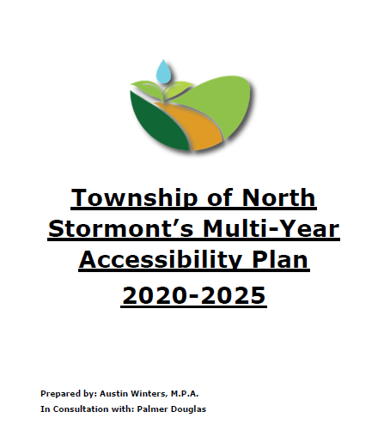
Creation of a Multi-Year Accessibility Plan
In 2020, the Township hired a Summer Student to curate a multi-year accessibility plan that laid out the priorities in improving the accessibility of municipal facilities while also outlining our approach to being an inclusive and accessible service provider and workplace.
In collaboration with Department Heads, the student undertook site inspections of all the facilities under the Township’s purview and applied the requirements from the Building Code and AODA to identify existing or potential accessible barriers.

Slide 3
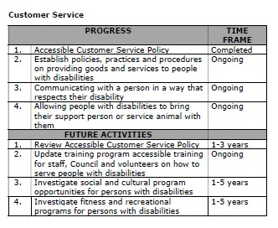
Area of Focus for Improving Accessibility: Customer Service

Slide 4
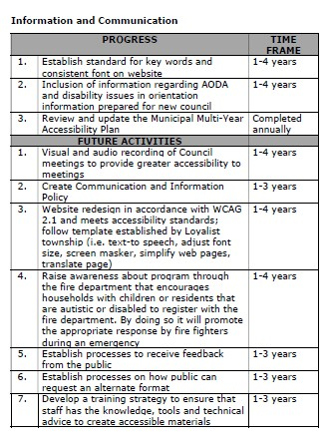
Area of Focus for Improving Accessibility: Information and Communication

Slide 5
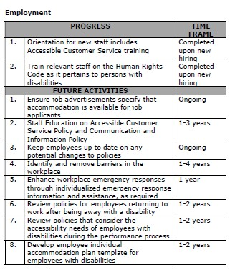
Area of Focus for Improving Accessibility: Employment

Slide 6
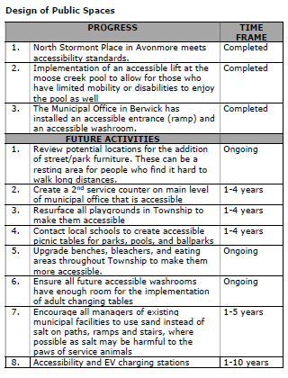
Area of Focus for Improving Accessibility: Design of Public Spaces

Slide 7
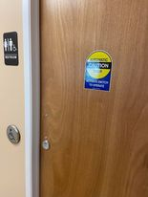
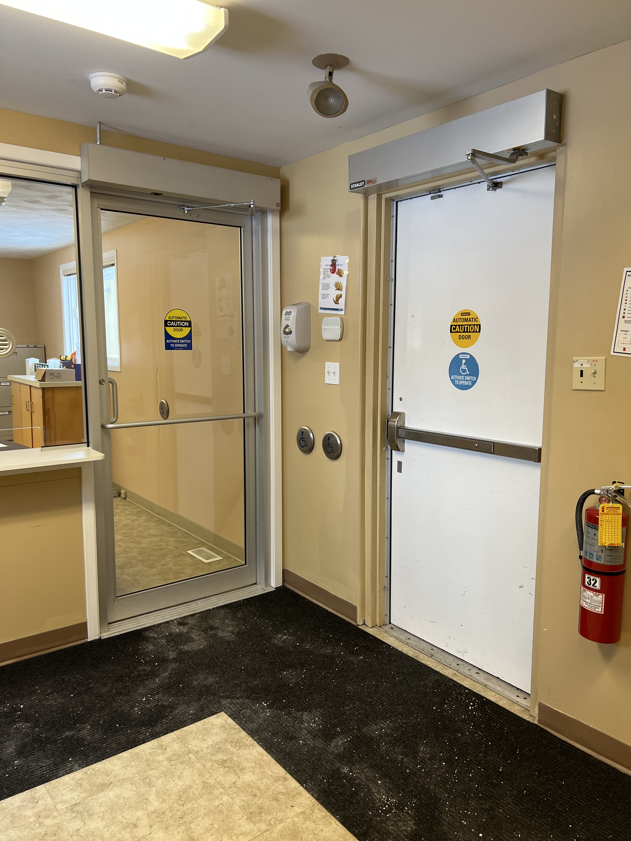
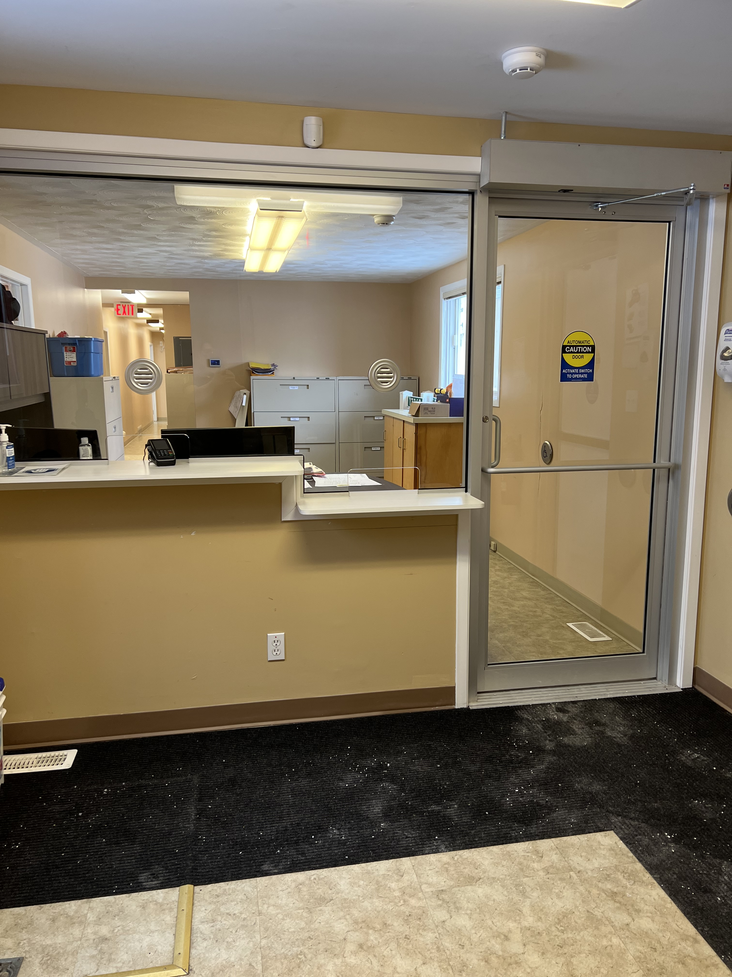
Accessibility Projects Completed from 2020-21: Township Office

Slide 8
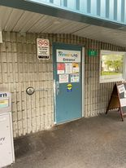
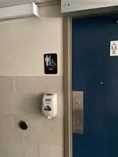
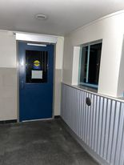
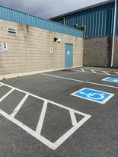
Accessibility Projects Completed from 2020-21: Finch Arena/Library

Slide 9
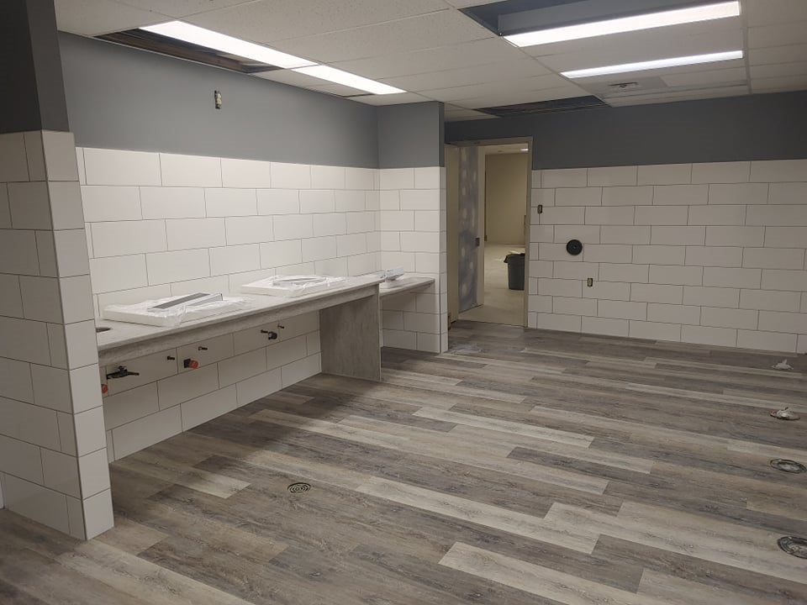
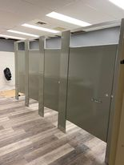
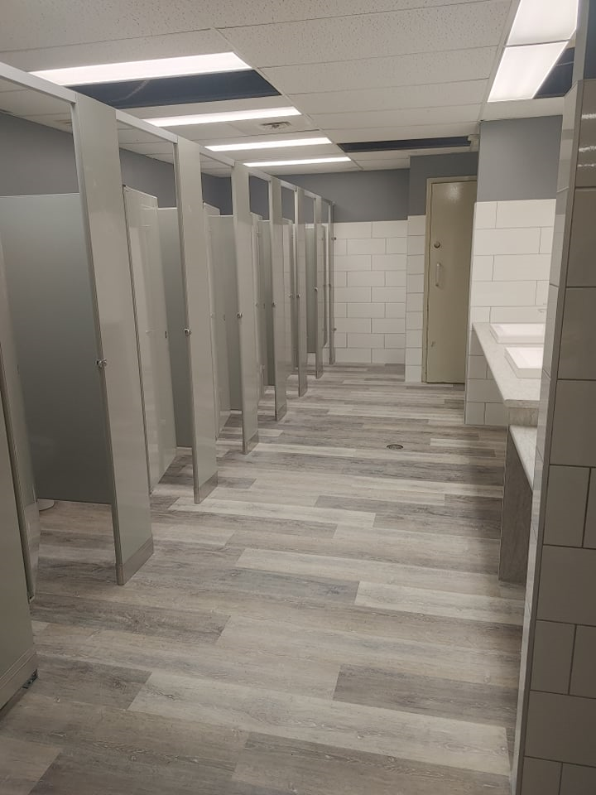
Accessibility Projects Completed from 2020-21: Crysler Community Centre

Slide 10
Creation of a New Website
With the new website it is imperative that we maintain our status of accessibility. The township in partnership with our consultant Palmer Douglas we have been able to continue the maintain the level of service expected by the residents requiring the service.
All documents are available in different formats and can be requested via e-mail or the clerk’s office or by calling our office.

Slide 11
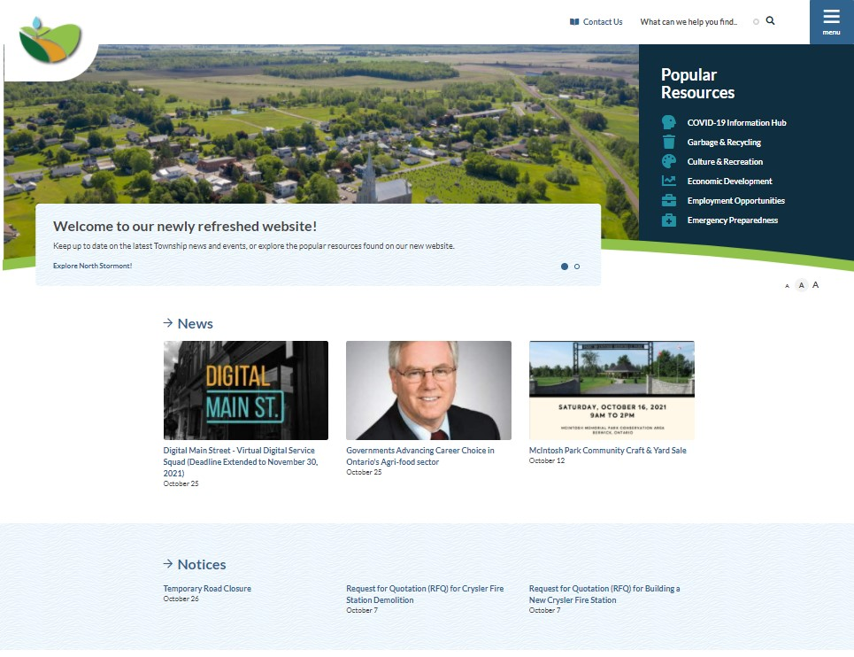
Accessibility Projects Completed from 2020-21: Township Website

Slide 12
Accessibility Projects Prioritized this Upcoming Year
We are currently working on 2022 budget.
Projects have not been finalized.

